Slide 1
Advanced Java Programming B.Sc.CSIT Seventh Semester
By Narayan Subedi

Slide 2
Java Network Programming

Slide 3
Java Network Programming
Introduction to Network Programming
The term network programming refers to writing programs that execute across multiple devices (computers), in which the devices are all connected to each other using a network.
The java.net package of the J2SE APIs contains a collection of classes and interfaces that provide the low-level communication details, allowing you to write programs that focus on solving the problem at hand.

Slide 4
Java Network Programming
TCP:
TCP stands for Transmission Control Protocol, which allows for reliable communication between two applications. TCP is typically used over the Internet Protocol, which is referred to as TCP/IP.
UDP:
UDP stands for User Datagram Protocol, a connection-less protocol that allows for packets of data to be transmitted between applications.
The speed for TCP is slower than UDP. UDP is faster because there is no error-checking for packets.
In TCP, there is absolute guarantee that the data transferred remains intact and arrives in the same order in which it was sent. In UDP, there is no guarantee that the messages or packets sent would reach at all.

Slide 5
Java Network Programming
IP Address : (Ex: 192.168.1.1)
An Internet Protocol address (IP address) is a numerical label assigned to each device (e.g., computer, printer) participating in a computer network that uses the Internet Protocol for communication.
Port Number:
In TCP/IP and UDP networks, an endpoint to a logical connection. The port number identifies what type of port it is. For example, port 80 is used for HTTP traffic.

Slide 6
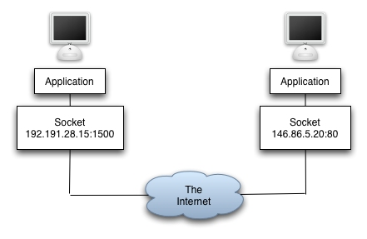
Java Network Programming
Socket:
A socket is one endpoint of a two-way communication link between two programs running on the network. A socket is bound to a port number so that the TCP layer can identify the application that data is destined to be sent to.
An endpoint is a combination of an IP address and a port number. Every TCP connection can be uniquely identified by its two endpoints. That way you can have multiple connections between your host and the serve

Slide 7
Java Network Programming
URL
It is an acronym for Uniform Resource Locator and is a reference (an address) to a resource on the Internet. A URL has two main components: Protocol identifier: For the URL http://example.com , the protocol identifier is http . Resource name: For the URL http://example.com , the resource name is example.com .
java.net.URL
Class URL represents a Uniform Resource Locator, a pointer to a "resource" on the World Wide Web. A resource can be something as simple as a file or a directory, or it can be a reference to a more complicated object, such as a query to a database or to a search engine.

Slide 8
Java Network Programming
java.net.URLConnection
The abstract class URLConnection is the superclass of all classes (HttpURLConncetion…) that represent a communications link between the application and a URL. Instances of this class can be used both to read from and to write to the resource referenced by the URL. In general, creating a connection to a URL is a multistep process using openConnection() and connect()
The connection object is created by invoking the openConnection method on a URL.
The setup parameters and general request properties are manipulated.
The actual connection to the remote object is made, using the connect method.
The remote object becomes available. The header fields and the contents of the remote object can be accessed.

Slide 9
Java Network Programming
URL & URLConnection Example

Slide 10
Java Network Programming
Creating a client/server application using TCP Sockets
Creating a client/server application using UDP Datagram
Send Email

Slide 11
Questions ???

